Slide 1
HotBox
Final Presentation
Group 14

Slide 2
Chaitanya Vemuri
Major: Computer Engineering
Role: Backend
Austin Tillotson
Major: Computer Engineering
Role: Frontend
Haafiz Shafau
Major: Computer Engineering
Role: Hardware
Ahmed Kazzoun
Major: Computer Engineering
Role: Hardware/Embedded

Slide 3
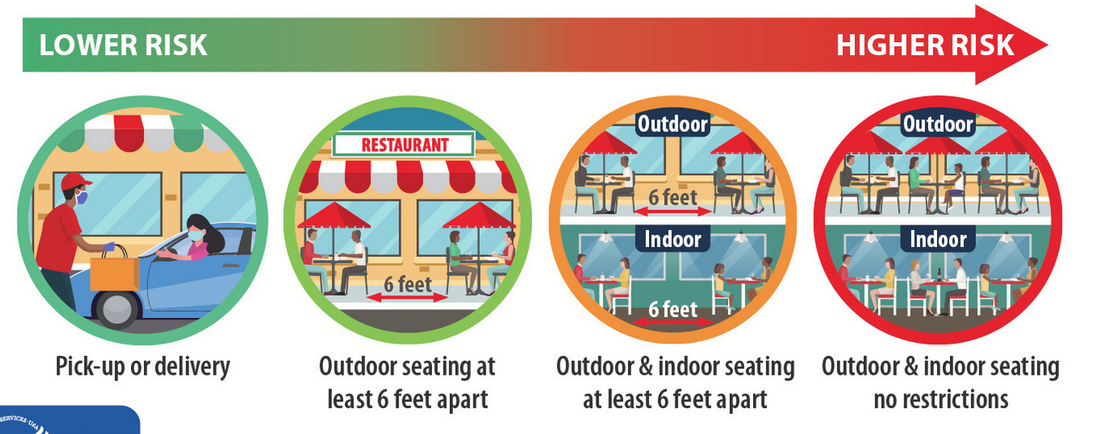
Motivation
Warm meals at your convenience
In 2020, over 60% of americans ordered takeout/delivery at least once a week. And with the COVID-19 pandemic, online ordering became high in demand.
Services such as DoorDash, UberEats, Online ordering and In-Store pickup became almost necessary to restaurants/stores. Thus still keeping traffic at these stores high.
A lot of the time, the food is prepared and left outside and becomes cold waiting for the customer/driver to pick up the food.

Slide 4
The Solution
The HotBox houses foods stored in different materials, and keeps the contents warm and secure in a insulated locked electrical heating box.
The Hotbox sends out a notification to the customer, alerting them when their food is ready for pick up.
The HotBox scans in customer codes for order validation to increase the security of the box.

Slide 5
Goals and Objectives
Effectively keep product warm
Send notifications alerting when food is ready to be picked
Safe to use
User friendly
Responsive
Database Storage
Secure
Order Validation

Slide 6
Hardware Specifications and Requirements
Box size must be large enough to accommodate different fast foods. (Minimum size : 10" x 10" x 10”)
Ability to set temperature and vary temperature as needed within a range of 110°F and 140°F
Box must support different materials such as cardboard and plastic inside the box while idle and heating.
Box must securely lock order when placed inside the box. Must only unlock when correct barcode is scanned
Able to be power multiple different voltages by a single 120VAC wall line

Slide 7
Software Objectives
Communication between MCU and WebApp
LCD displays box and order number for customer
Web app must know the status of the boxes
Software must be able to control the temperature of the boxes
Database containing box orders
Software must generate barcode for a created order

Slide 8
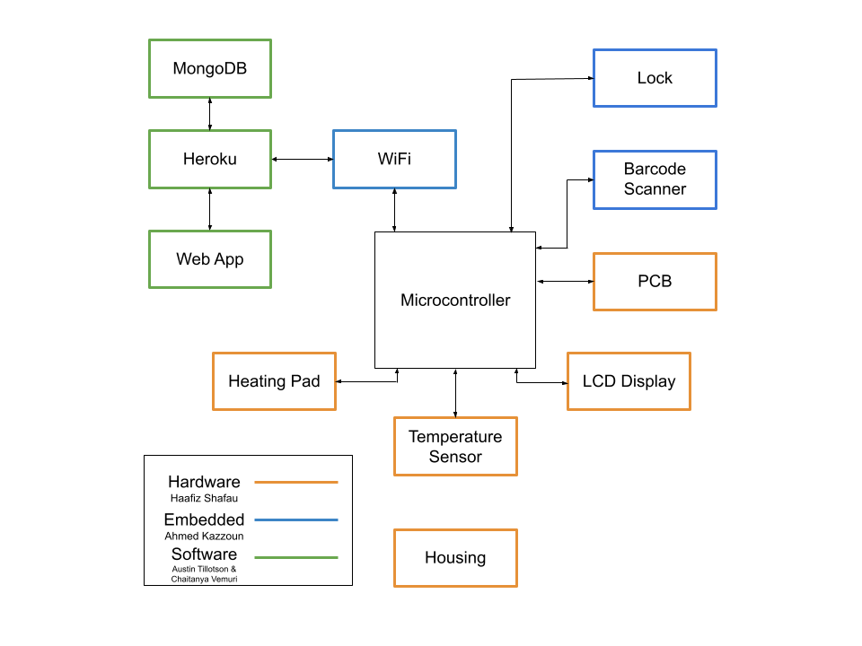
Block Diagram

Slide 9
Hardware Design

Slide 10
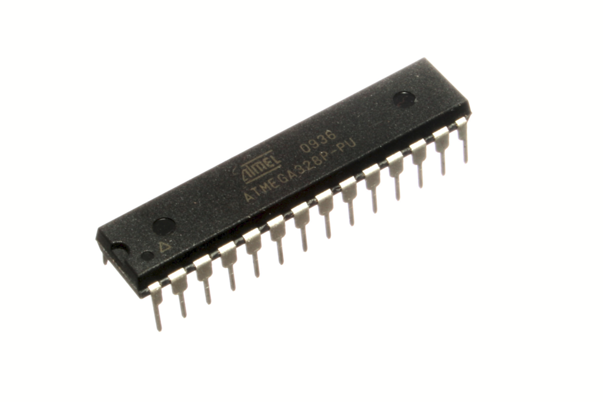
Microcontroller
Microcontroller selection
ATmega328P-PU Specifications
Operating Voltage | 1.8-5.5V
Memory type | Flash
Communication Interfaces | 1-UART, 2-SPI, 1-I2C
Memory Size | 32KB
Pin Count | 32
Manufacturer | Microchip

Slide 11
Microcontroller
Microcontroller schematic

Slide 12
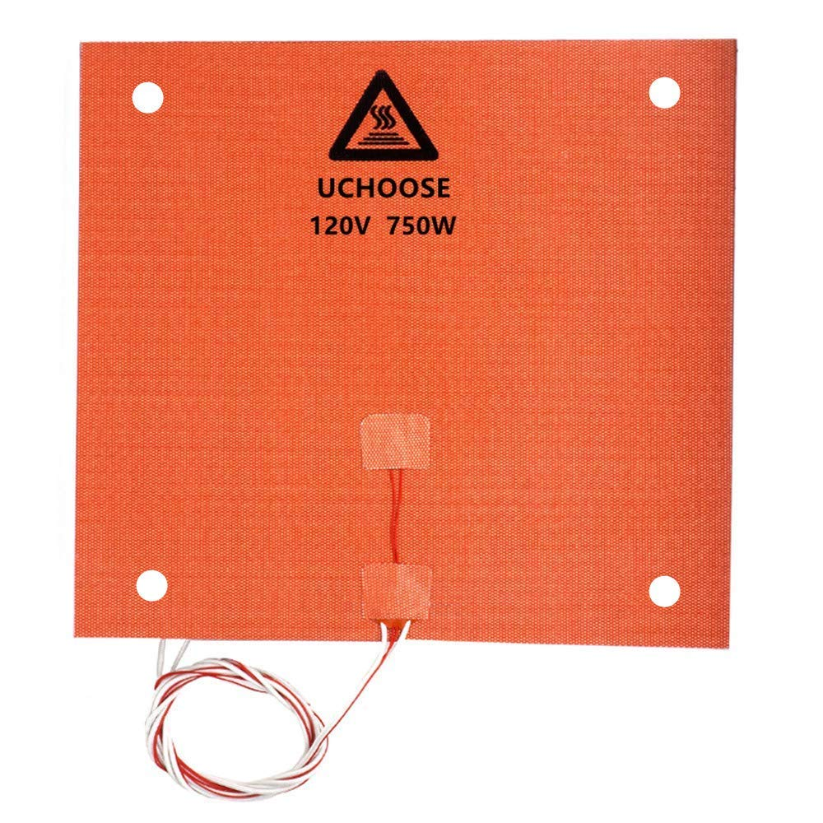
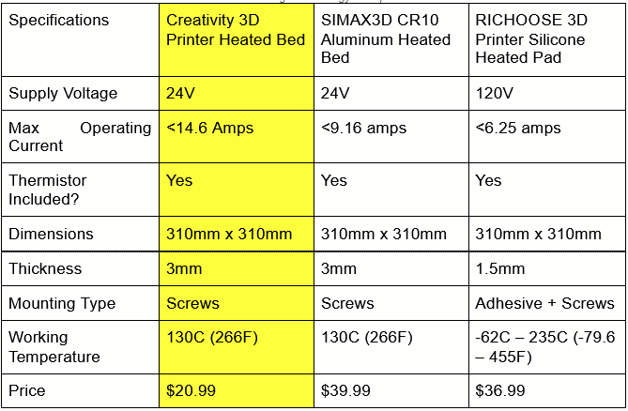
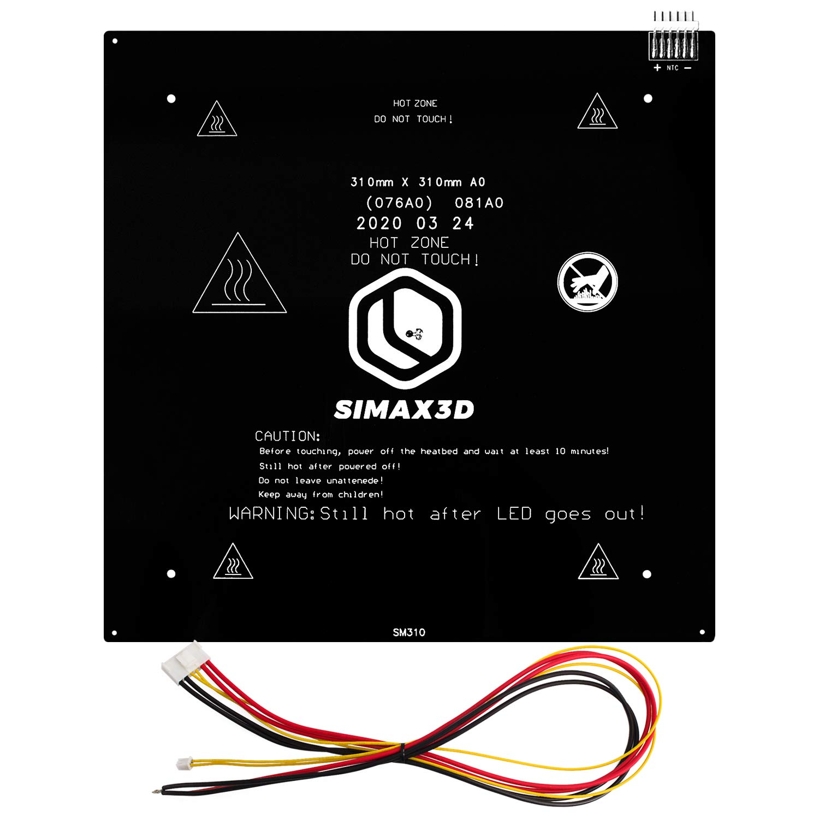
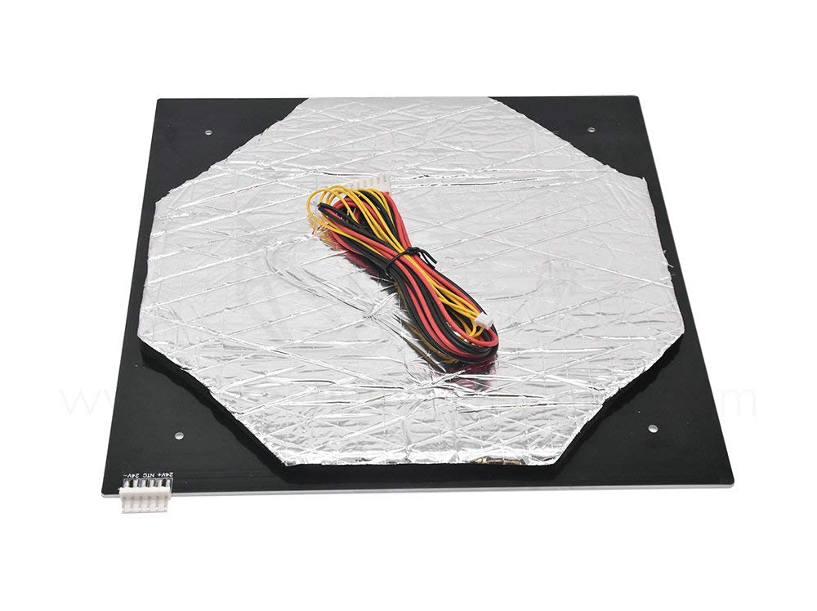
Heating Plate
Heating plate selection
RICHOOSE 3D Heated Pad
SIMAX3D Heated Bed
Creativity 3D Heated Bed

Slide 13
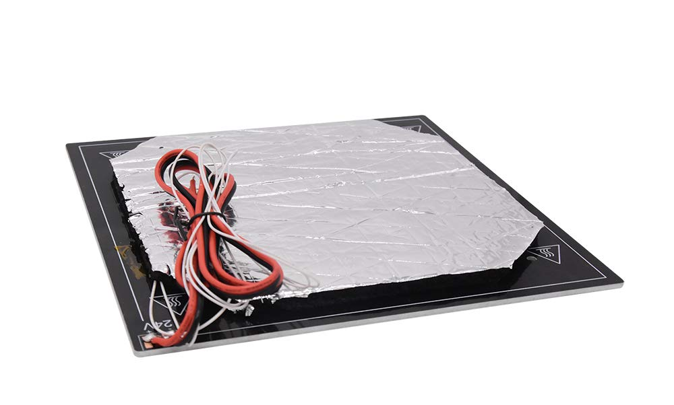
Heating Plate
Creativity 3D Heated Bed
Specifications
Supply Voltage | 24V
Operating Current | <14.6Amps
Manufacturer | Creativity
Dimensions (LxW) | 310mm x 310mm
Thickness | 3mm
Maximum Temperature | 130C (266F)

Slide 14
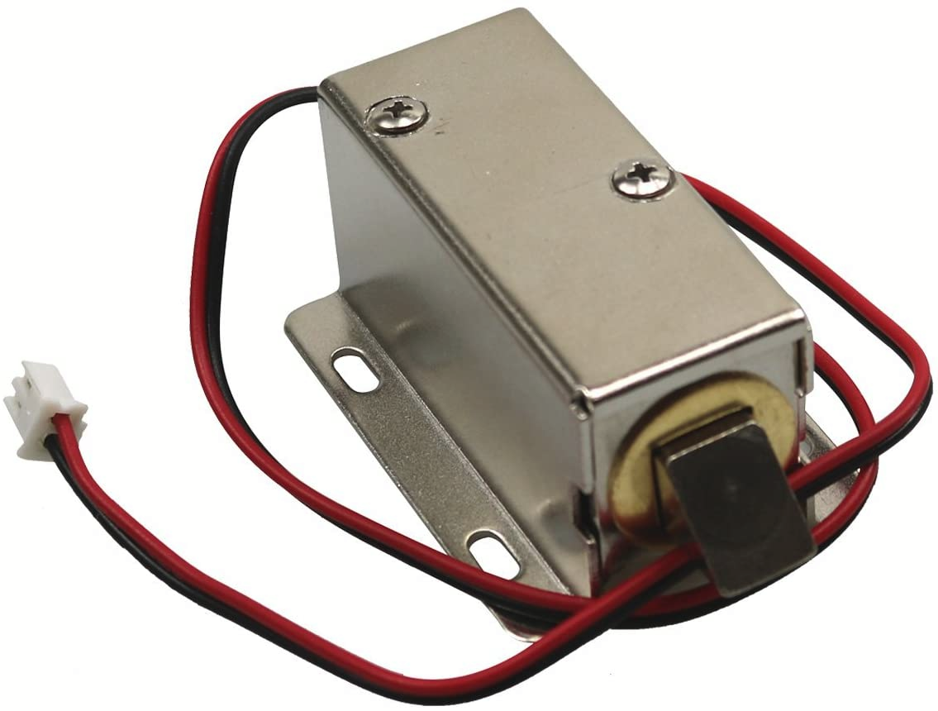
Solenoid Lock
MXBB DC 12V 0.8A 10mm Stroke Electronic Cabinet Lock
Specifications
Supply Voltage DC | 12V
Operating Current | .8A
Manufacturer | MXBB
Dimensions (LxWxH) | 2.13 x 1.54 x 1.1 inches
Material: | Metal
Weight | 155 grams
Unlocking time | ≤1S

Slide 15
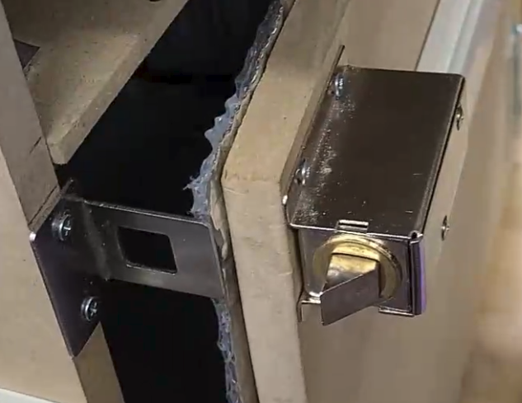
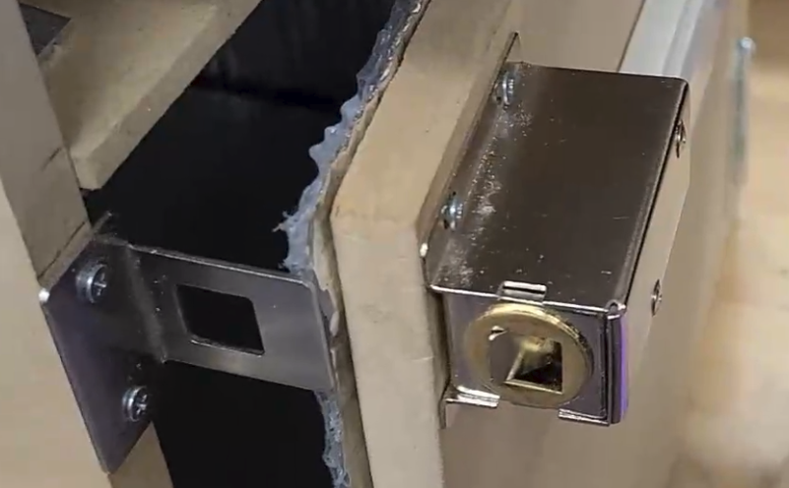
Solenoid Lock
Solenoid Lock Testing
Locked position
Unlocked position

Slide 16
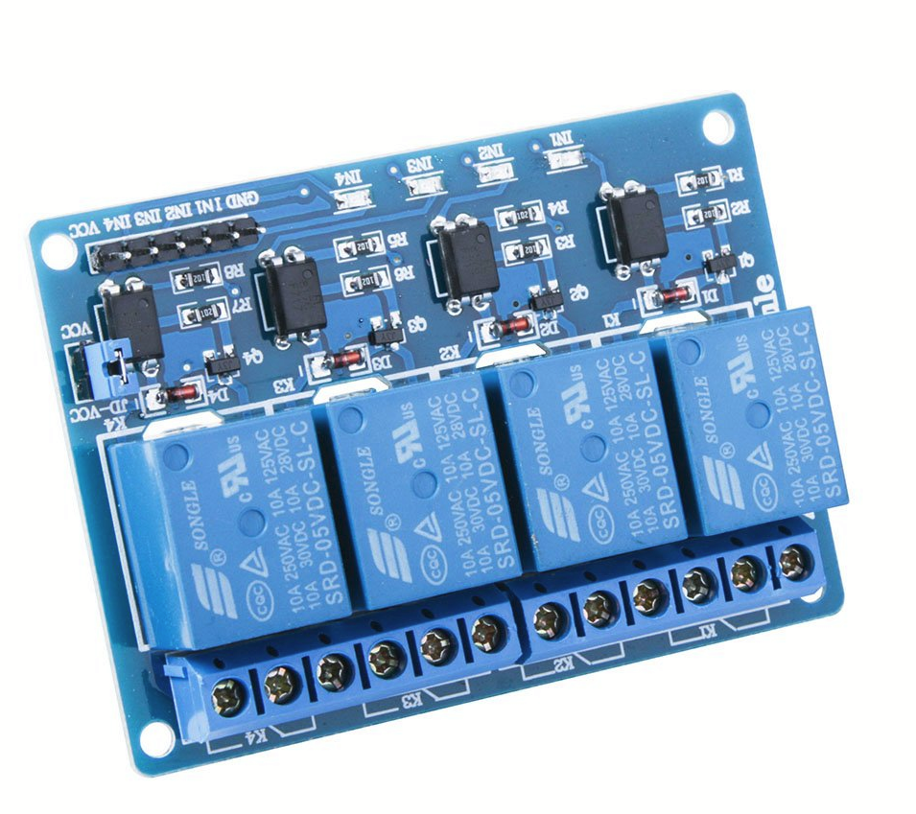
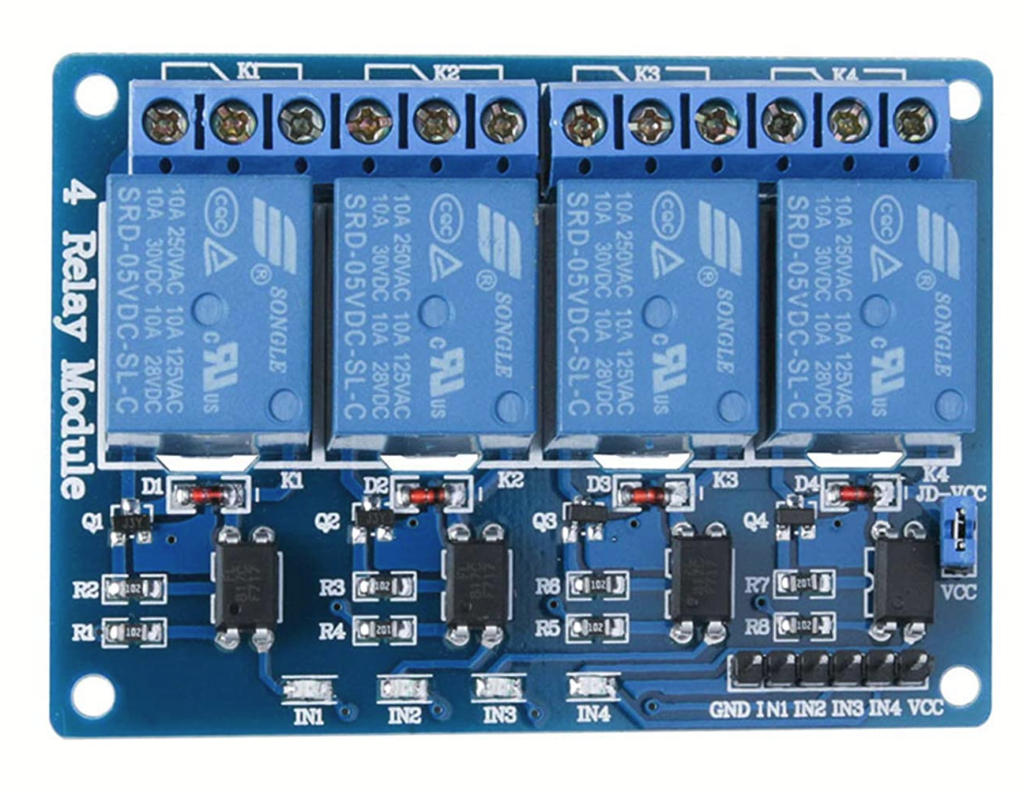
5V Relay
5V active low relay module equipped with 4 channels
Standard interface can be directly connected to a wide variety of microcontrollers (including Arduino)
Will be used to control devices that operate at higher voltages i.e Heating Pad, Solenoid Lock
Specifications
Power Supply DC | 5V
Load Voltage | AC 250V, DC 30V
Load Current | 10A
Manufacturer | ELEGOO
Dimensions (LxWxH) | 2.76 x 2.36 x 0.7 inches
Weight | 122 grams

Slide 17
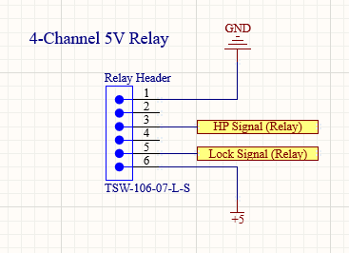
5V Relay Schematic
Pin | Label | Type | Description
1 | GND | GROUND | Power Ground
2 | IN1 | Input | Input Signal 1
3 | IN2 | Input | Input Signal 2
4 | IN3 | Input | Input Signal 3
5 | IN4 | Input | Input Signal 4
6 | VCC | POWER | 5V Power Supply
HP Signal - Heating Pad Signal
Lock Signal - Solenoid Lock Signal

Slide 18
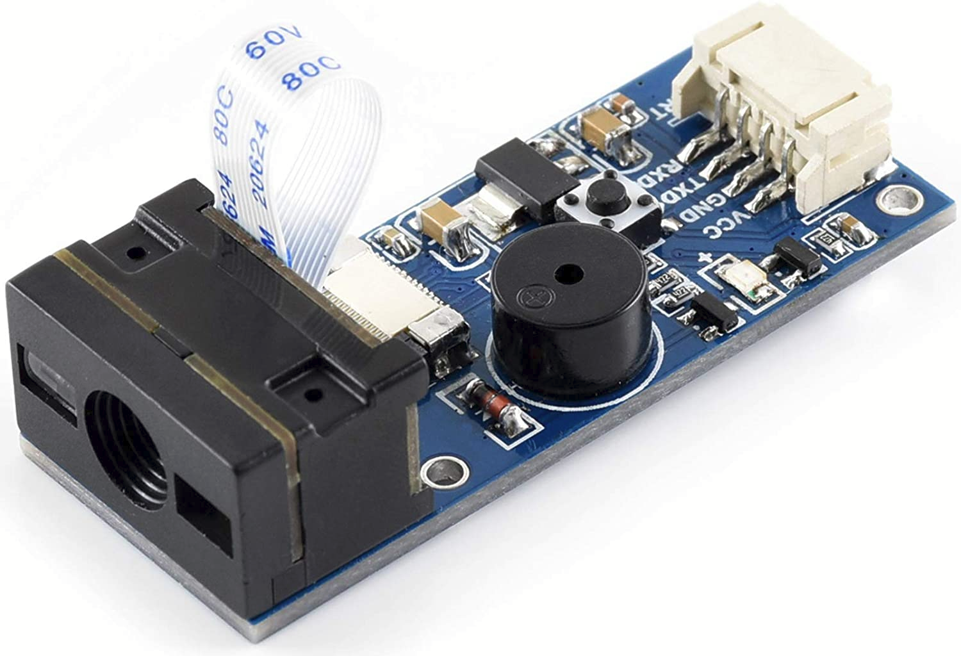
Barcode Scanner
Waveshare Barcode Scanner Module 1D/2D Codes Barcode
Dimensions (LxW): 65x28x13.7mm
Onboard Micro USB interface
UART interface
Can scan in both 1D format and 2D format
2D format: QR Code, PDF417, Data Matrix
Operating voltage: 5V
Operating Current: 135mA

Slide 19
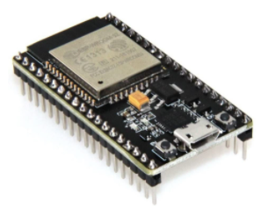
Wi-Fi Module
ESP32-DEVKITC-32D
2.4 GHz WiFi and Bluetooth module that integrates the TSMC ultra-low power technology.
IEEE 802.11 standard security features all supported, including WFA, WPA/WPA2 and WAPI
Made with the official WROOM32 module
That module contains a dual-core ESP32 chip, 4 MB of SPI Flash, tuned antenna.
Built-in USB-to-Serial converter, automatic bootloader reset, Lithium Ion/Polymer charger.

Slide 20
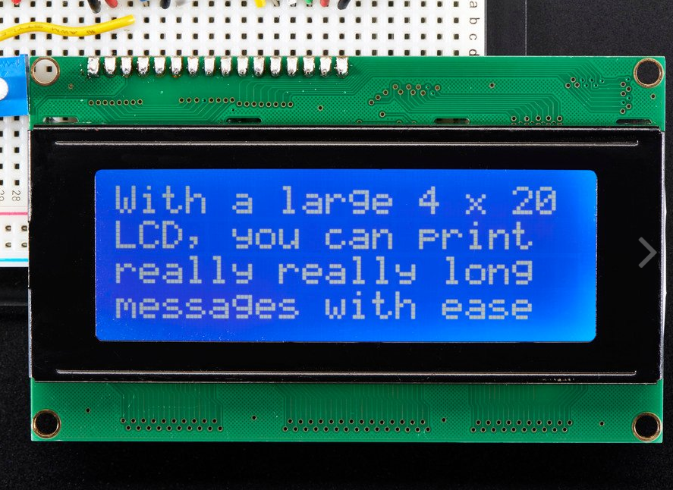
LCD Display
Adafruit RGB backlight positive LCD 24x4
Specifications
Supply Voltage DC | 3V or 5V
Manufacturer | Adafruit
Dimensions (LxWxH) | 27mm x 71mm / 1.1in x 2.8 in
Display Length | 20 characters wide, 4 rows
Languages | English/Japanese text

Slide 21
Overall PCB Schematic
Designed on EasyEDA Designer

Slide 22
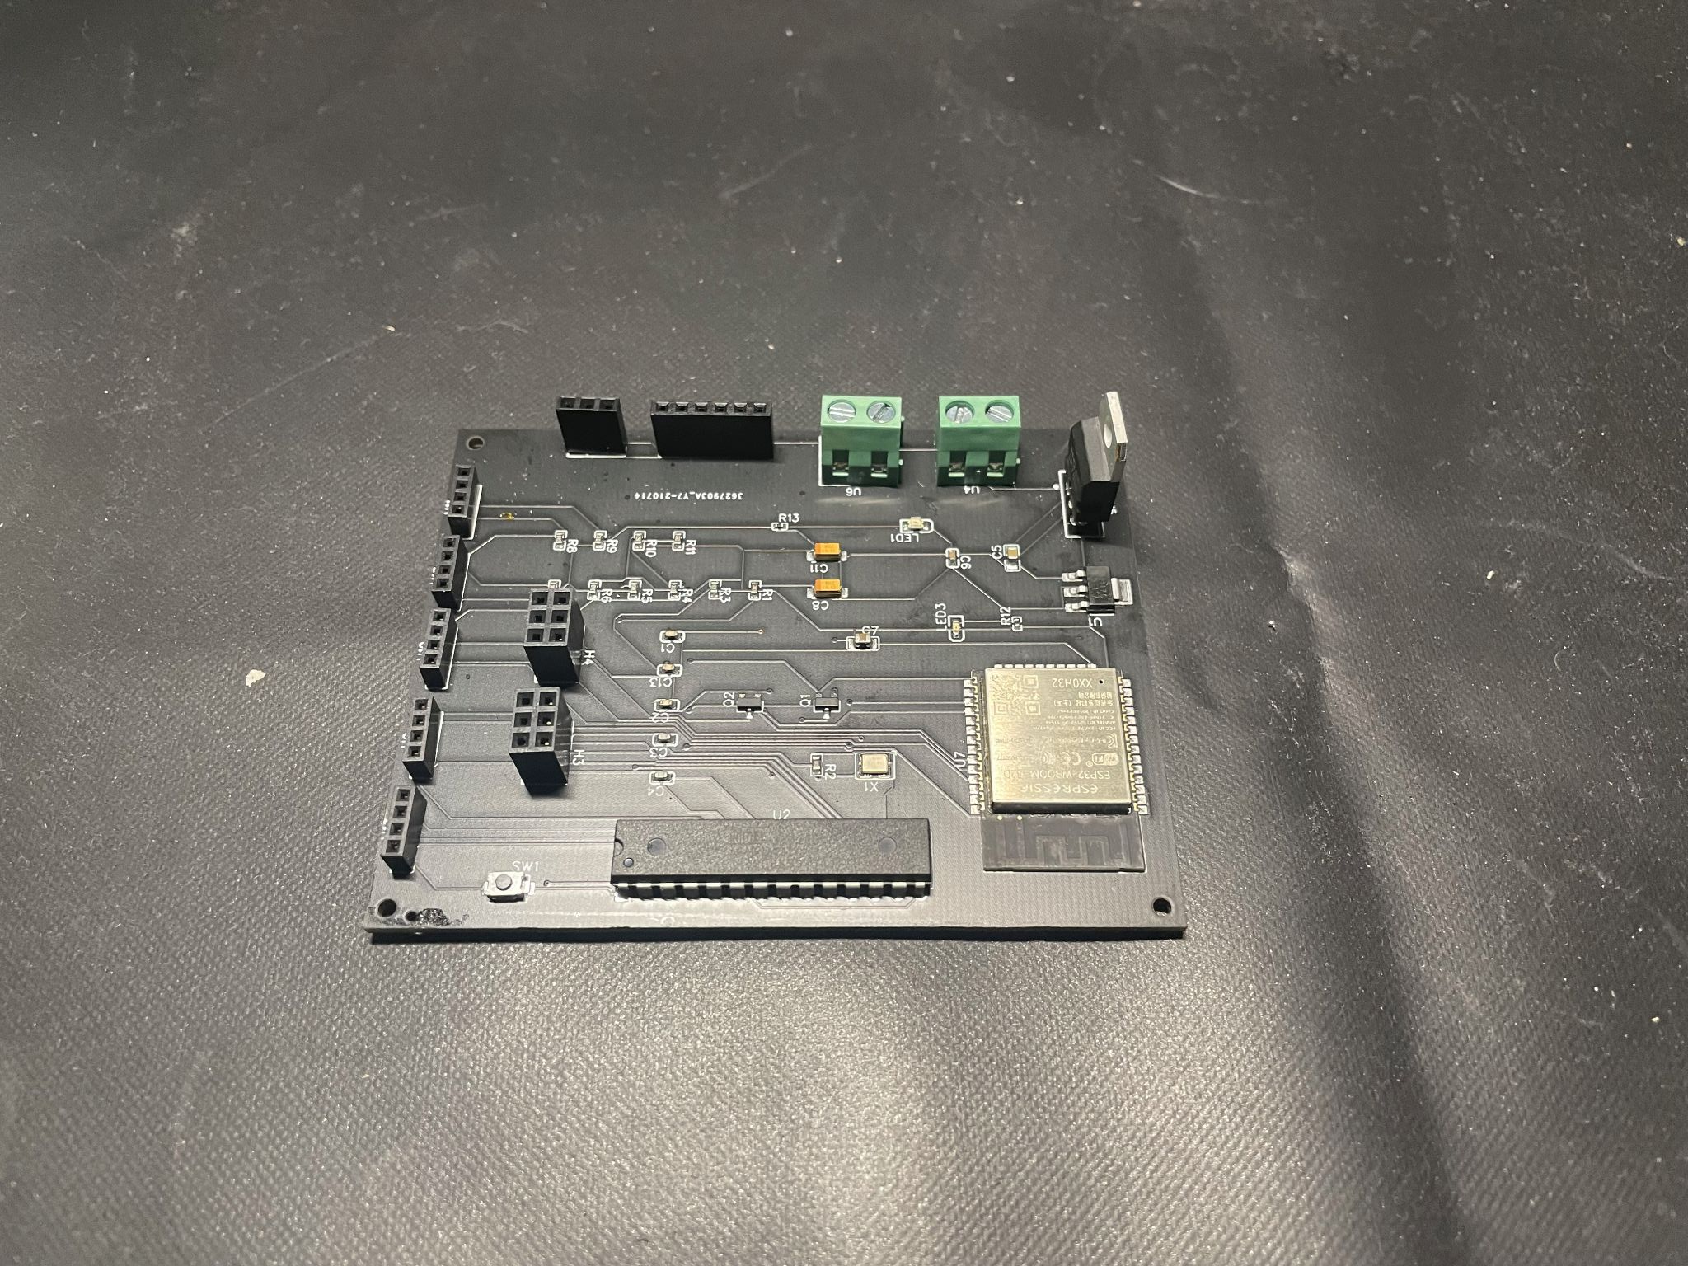
Final Custom PCB
Manufactured and assembled by JLPCB
Final Custom PCB

Slide 23
Box Housing Design
Housing was one of the more important things we had to take a look at as it would enclose all the items in the box. Our enclosure must:
Support the size of standard take out foods
Support different materials
Sturdy
Malleable
Insulated
Wooden Exterior

Slide 24
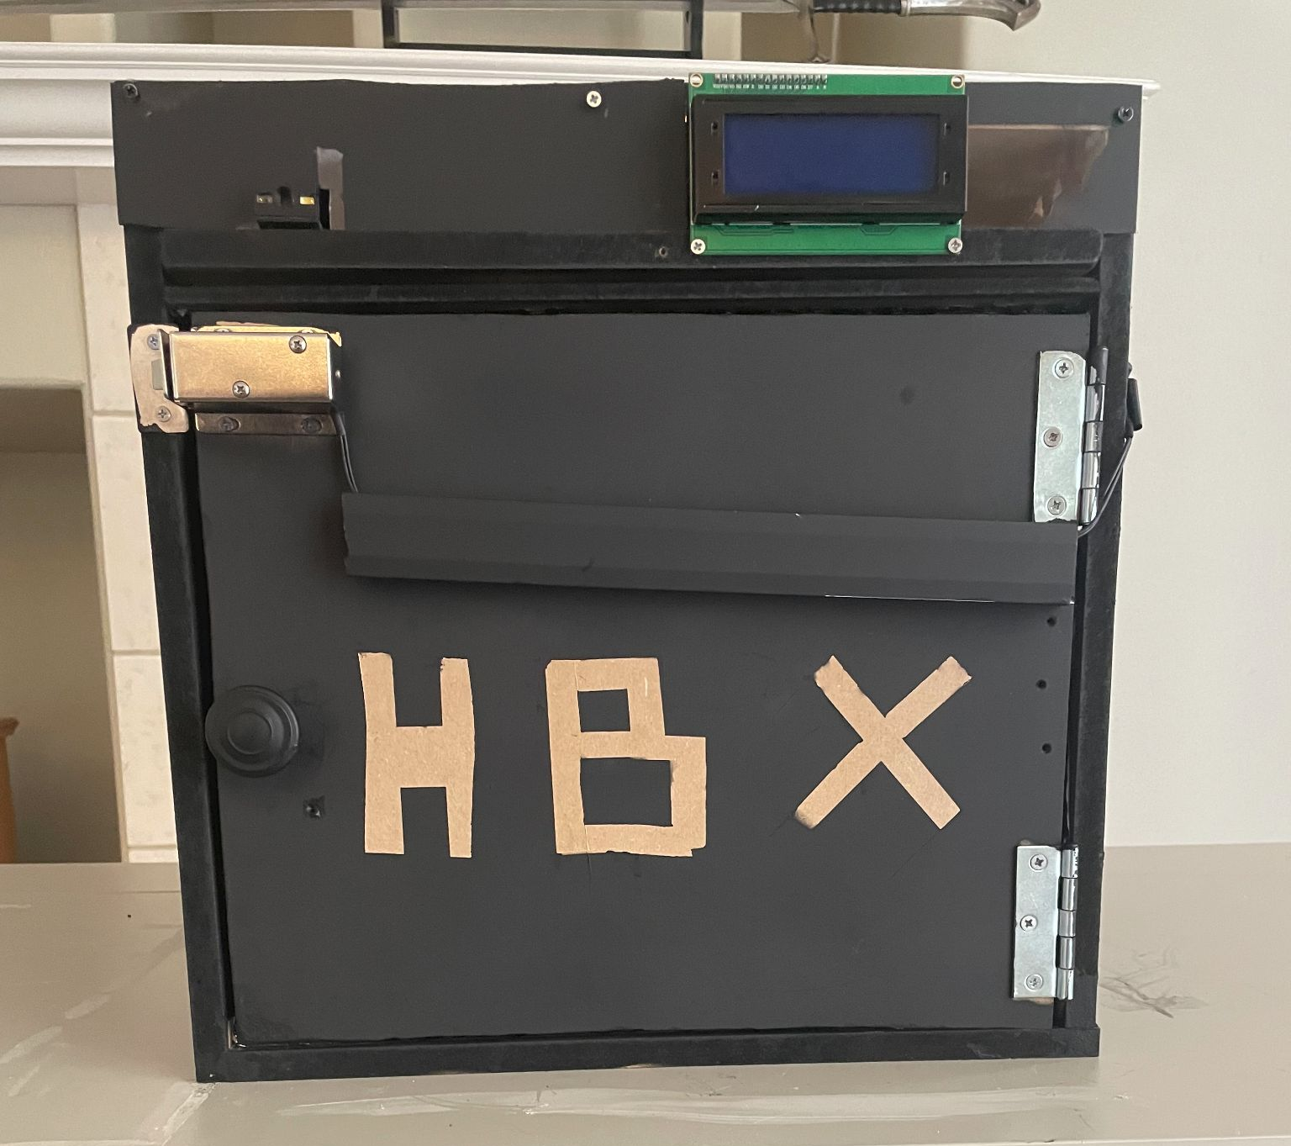
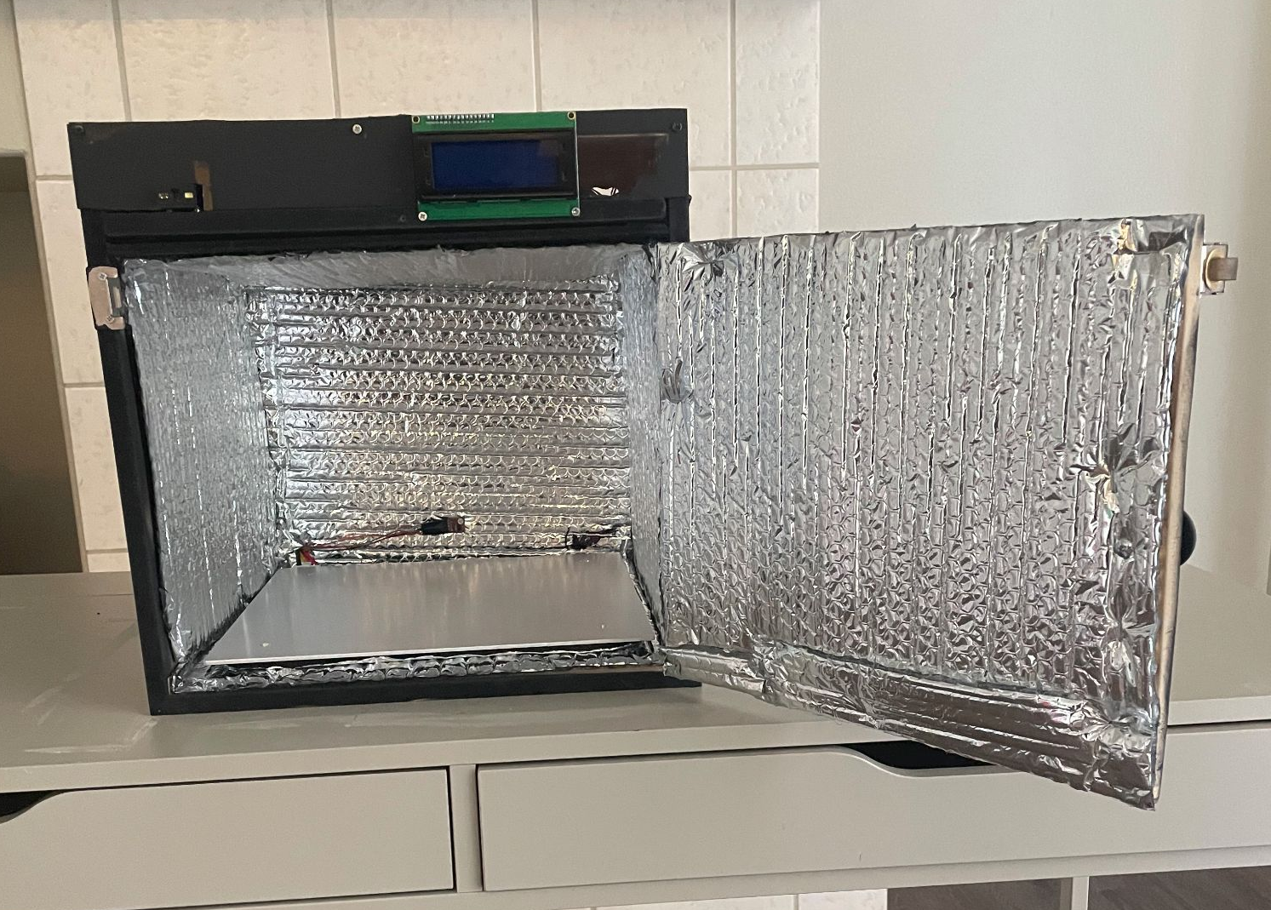
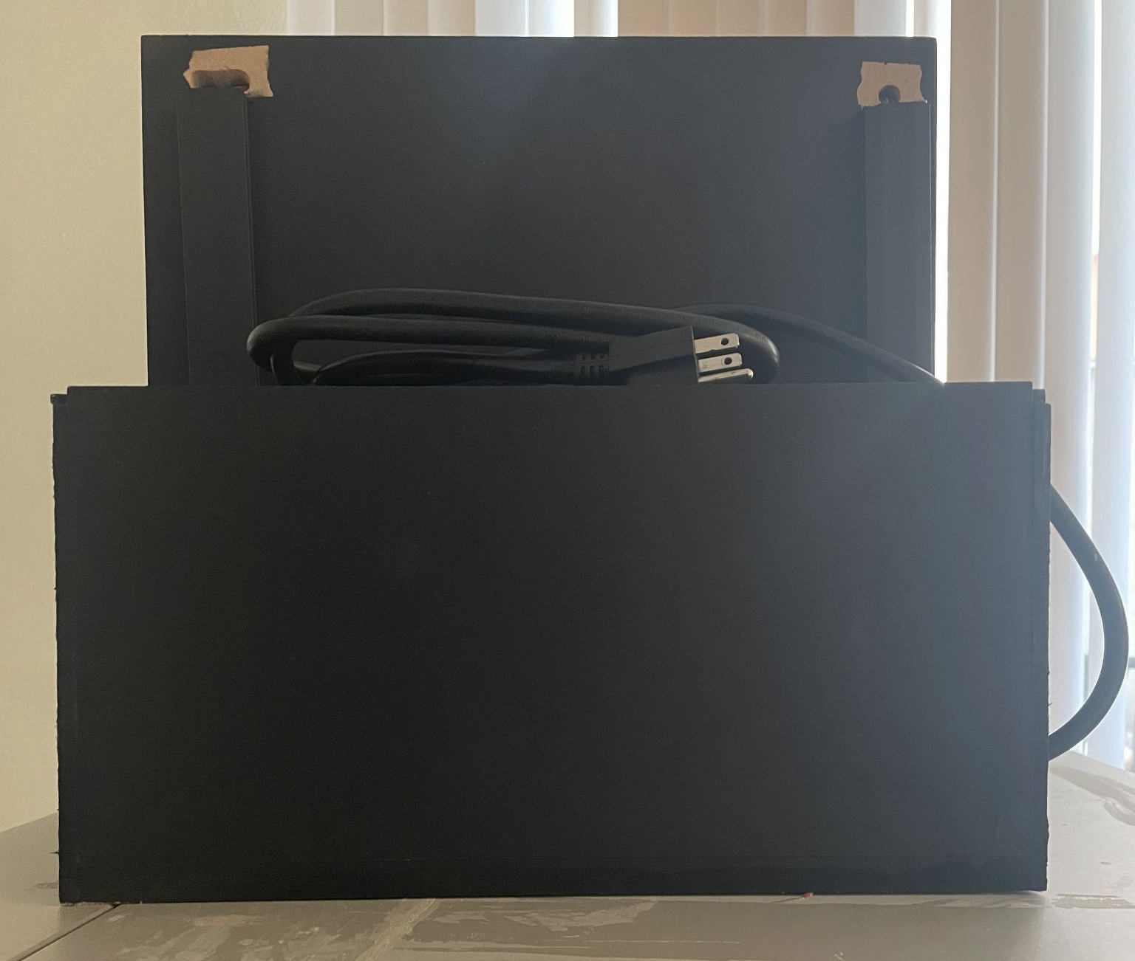
Box Housing Design
Part | Length (in) | Width (in) | Height (in)
Exterior | 14” | 14” | 14”
Interior | 13” | 14” | 12”
Electronics Compartment | 14.5” | 14.5” | 2.5”
Transformer Compartment | 14” | 5-⅜” | 7-¼”
Door | 13-⅛” | ½” | 11”
Front View
Interior View
Rear View
Side View

Slide 25
Software Design

Slide 26
Software
Embedded Software is used for the functionality of the HotBox
Infinite loops awaiting requests
Displays details on LCD
Locks/unlocks box as necessary
Heats up box
Demo Site is used to send requests to the HotBox and Database
Allows user to place order, lock box, and edit box system
Generates barcode for placed order
Communicates box and order number to MCU
Stores information of boxes and order in Database

Slide 27
Technologies Used

Slide 28
Software Stack
MERN Stack
Database | MongoDB
Backend Framework | ExpressJS
Frontend Framework | ReactJS
Runtime Environment | NodeJS

Slide 29
Platform Programming Languages
Embedded
Using Arduino IDE, we wrote the embedded implementation primarily in C for the barcode scanner, temperature module, and the box switch.
Framework
Javascript was the primary language used, along with various npm packages for addons. ExpressJS, ReactJS, and NodeJS were used to write the frontend and backend framework.
Database
MongoDB uses MQL, which is a unique querying language, connected to the backend framework with the npm package mongoose.

Slide 30
Barcode Scanner
Create QRcode containing order information
Scan code to get order information
Code is scanned by the scanner.
ESP verifies that it matches what is stored in db.
The solenoid lock unlocks.
HotBox’s GitHub

Slide 31
Barcode Scanner Flowchart
Scan Barcode
Send data to MCU
Decipher and send to WiFi module
Unlock box
Did the WiFi module receive relay?
Yes
Update data in database
Send request to MCU to unlock box
No
Display Error

Slide 32
Temperature Modulation
Embedded software adjusting temperature of heating pad
Temperature set/controlled by Web App
Temperature is set by a three option dropdown in order form
Temp ranges from 110°F to 140°F
WebApp sends temp with order details to MCU
MCU tracks internal temp with sensor
MCU alternates Heating pad on/off to maintain temp

Slide 33
Demo Web Application
Hosted on Heroku
Web Application used to process orders
Communicates requests from user to HotBox
Displays status of all boxes in system
Contains order information for each box for viewing/reviewing
Stores order info in database
Gives orders to specific boxes and sends an email containing order information.

Slide 34
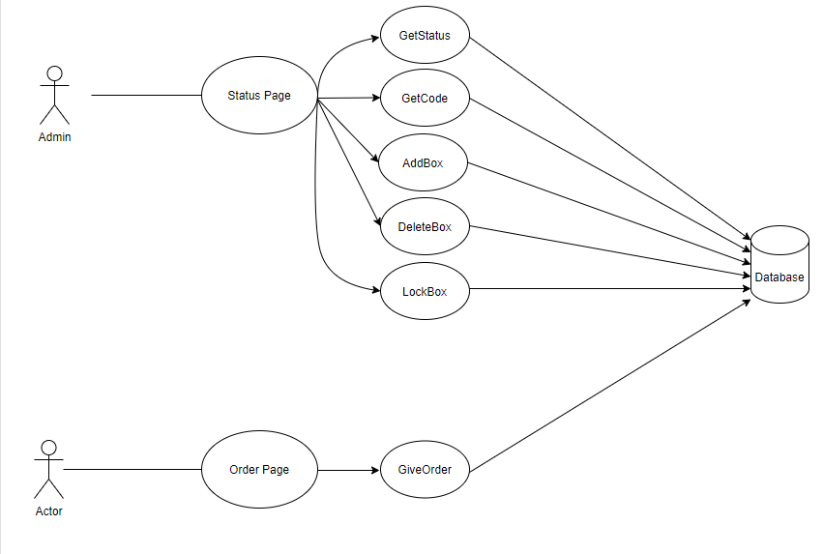
Use Case Diagram

Slide 35
Frontend
Main/Status page will display all boxes in system
Each box will
Display status (active or inactive)
Display order in box (if active)
Order page will create order
Admin commands to edit system
Add box to system
Delete box to system
Lock box
API communication with backend with fetch requests

Slide 36
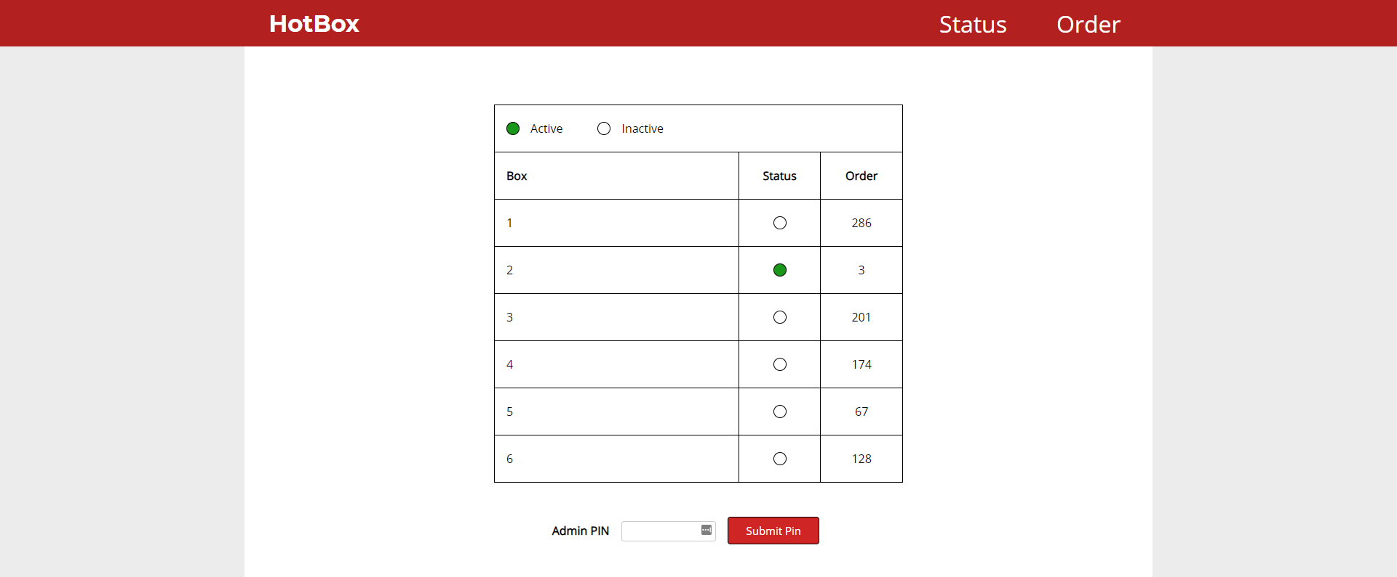
Status Page

Slide 37
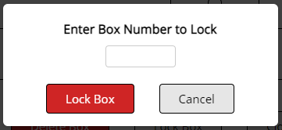
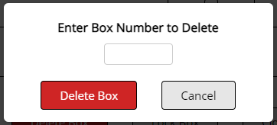
Admin Module

Slide 38
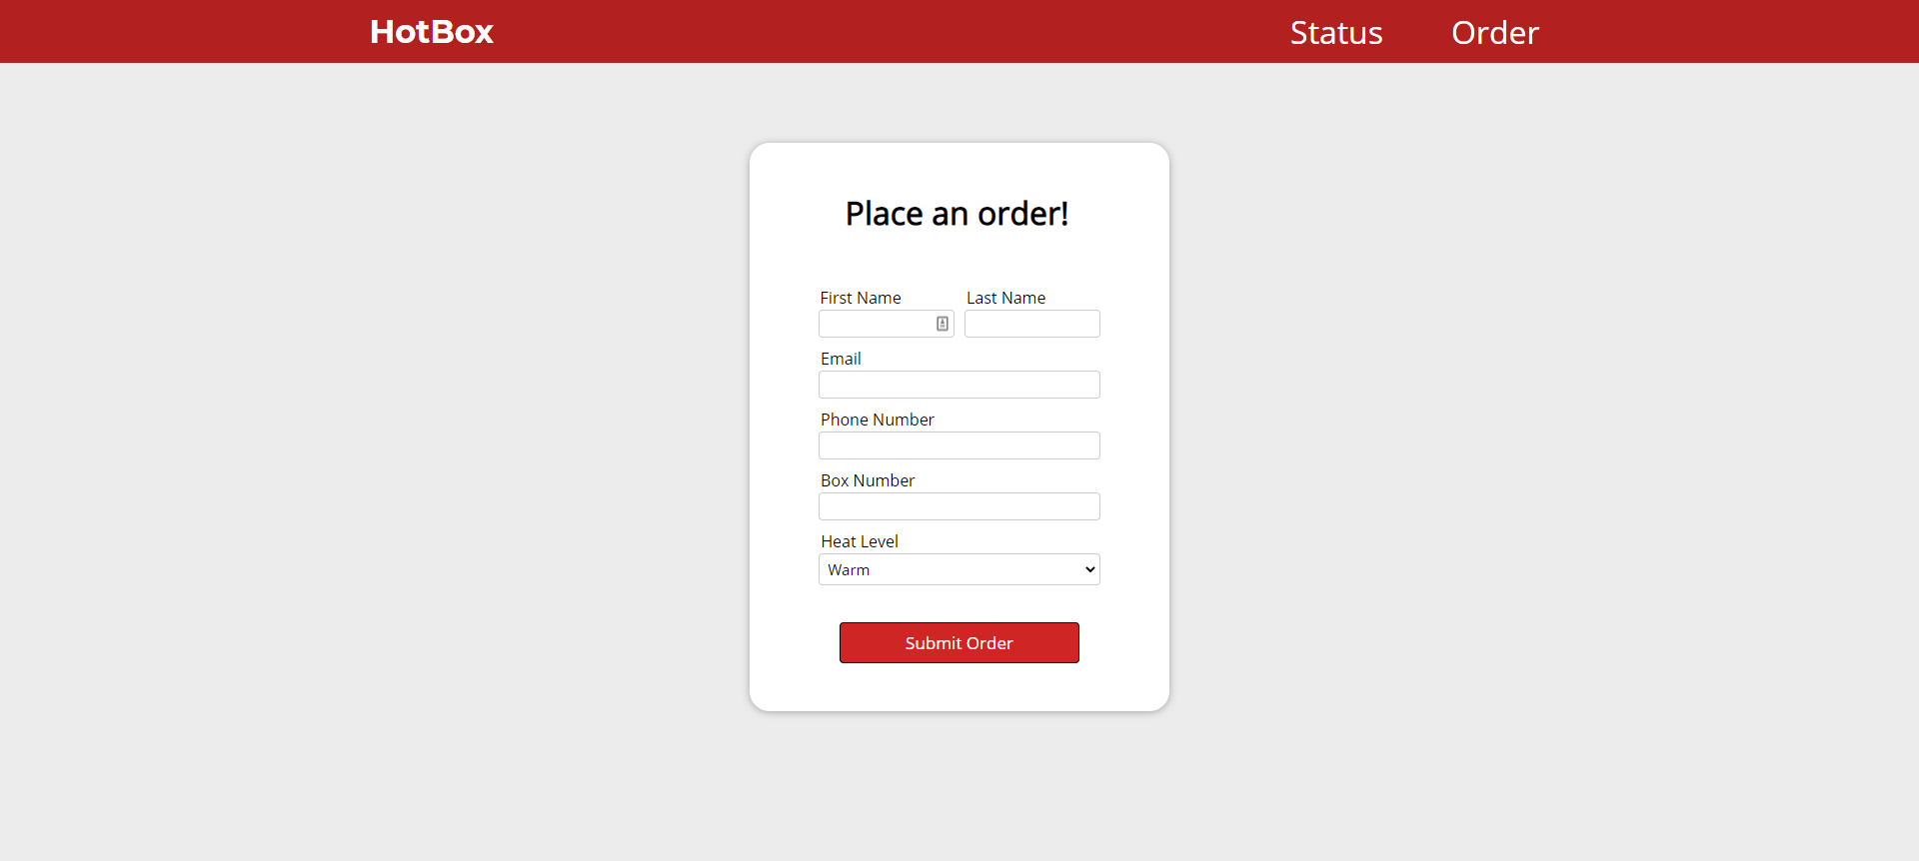
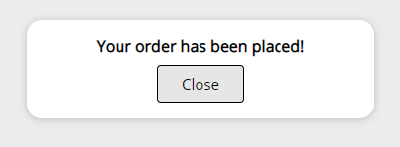
Order Page

Slide 39
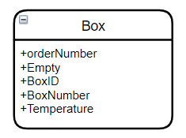
Backend
Schema for each box is stored in MongoDB.
Uses HTTP requests to create interactions between box, web app, and database.
Basic requests include:
AddBox
DeleteBox
GiveOrder
GetOrder
GetStatus
BoxStatus
LockBox
BoxStatusEmbedded
QRCode and Email implementation is done in the backend automatically.
Notes:
Record for postman

Slide 40
Postman Demo

Slide 41
Difficulties
Scheduling and Meeting
Work hours made it difficult to set meeting times
Lack of in person meetings made it hard to test embedded
Time limitations
Lost a month of development time due to summer semester
Parts
Part shipping time was not ideal
Multiple parts received did not work and had to be reordered
Multiple parts did not work as we intended to use them
Food sensor changed to WebApp lock box
Barcode
Generated barcodes not scanning
Swapped to QR Codes

Slide 42
Total Budget - $542.39
Parts | Quantity | Regular Cost | Shipping and Handling
Lock | 2 | $18.89 | $0.00 shipped by Amazon
Barcode Scanner | 1 | $46.12 | $0.00 shipped by Amazon
Relay | 1 | $7.99 | $0.00 shipped by Amazon
LCD Display | 2 | $10.43 | $0.00 shipped by Amazon
Wifi Module | 3 | $24.97 | $0.00 shipped by Amazon
Transformer | 2 | $34.88 | $0.00 shipped by Amazon
MEGA 2560 | 1 | $33.76 | $0.00 shipped by Amazon
Heating Bed | 1 | $20.99 | $0.00 shipped by Amazon
24v to 5 converter | 1 | $10.09 | $0.00 shipped by Amazon

Slide 43
Total Budget - $542.39(cont)
Parts | Quantity | Regular Cost | Shipping and Handling
Temperature sensor | 1 | $9.57 | $0.00 shipped by Amazon
24 to 12 converter | 1 | $10.63 | $0.00 shipped by Allied Electronics
Uart converter | 1 | $13.33 | $0.00 shipped by Amazon
Plexiglass | 13”x5” | $9.99 | $0.00 shipped by Amazon
Foil Insulation | 1 | $12.19 | $0.00 shipped by Amazon
Pack of Pin Headers | 1 | $3.99 | $0.00 shipped by Amazon
Infrared thermometer | 1 | $18.89 | $0.00 shipped by Amazon
Logic Level Shifter | 1 | $15.68 | $0.00 shipped by Amazon
Heavy Duty Plug | 1 | $12.99 | $0.00 shipped by Amazon

Slide 44
Total Budget - $542.39(cont)
Parts | Quantity | Regular Cost | Shipping and Handling
TTL UART to usb | 1 | $7.99 | $0.00 shipped by Amazon
Transformer | 2 | $35.99 | $0.00 shipped by Allied Electronics
DC power jack | 1 | $4.50 | $0.00 shipped by Amazon
Pack of breadboard jumper wires | 1 | $13.34 | $0.00 shipped by Amazon
400 Grit sandpaper | 1 | $4.99 | $0.00 bought at Autozone
40 Grit sandpaper | 1 | $5.19 | $0.00 bought at Autozone
Fiberwood | ¼ log | $8.02 | $0.00 bought at Home Depot
Paint, paint tape, screws, caulk, wood, glue, handle | 1 of each | $69.83 | $0.00 bought at Home Depot
JCLPCB | 2 | $63.15 | $4.35 shipped by JCLPCB

Slide 45
Questions?

